Slide 1
ENGF0002: Ethics Presentation
Aaryaman Sharma
Notes:
Hello, my name is Aaryaman and this is my ENGF0002 Ethics presentation.

Slide 2
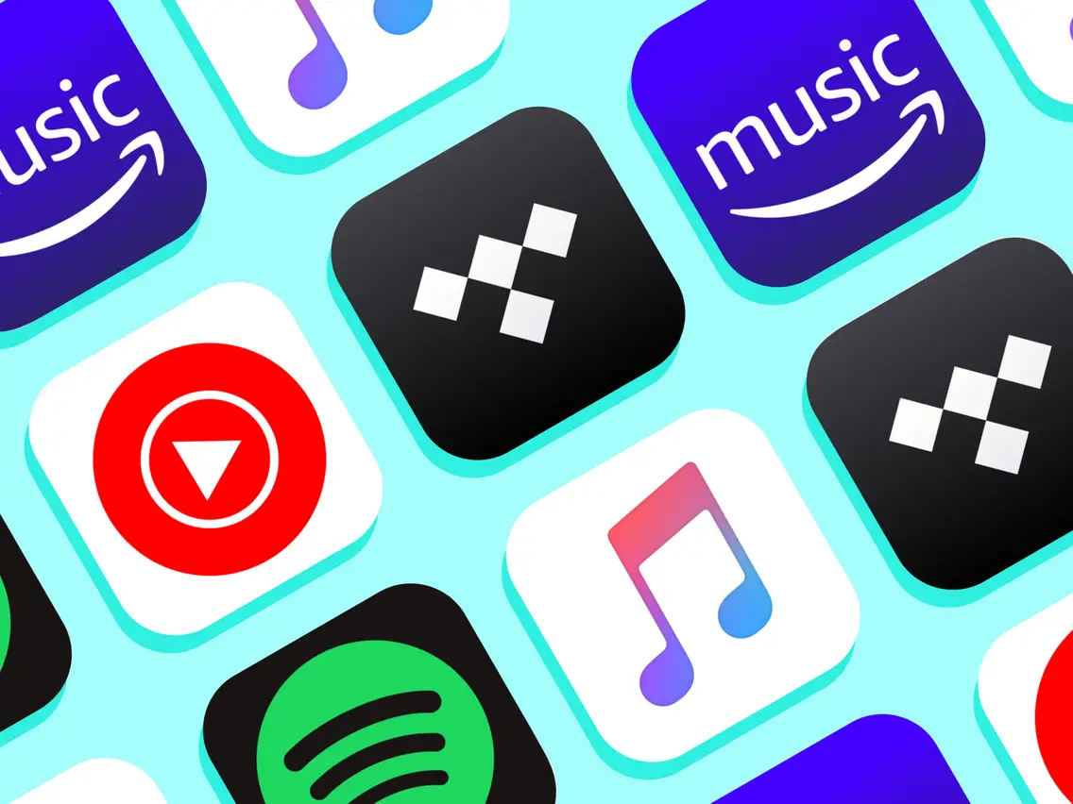
Introduction
01
Notes:
So, my ethics report will be tackling the massive world of online music streaming. I’m sure this topic needs no introduction as all of us have some experience with music streaming platforms such as Spotify, Apple Music, Pandora etc.

Slide 3
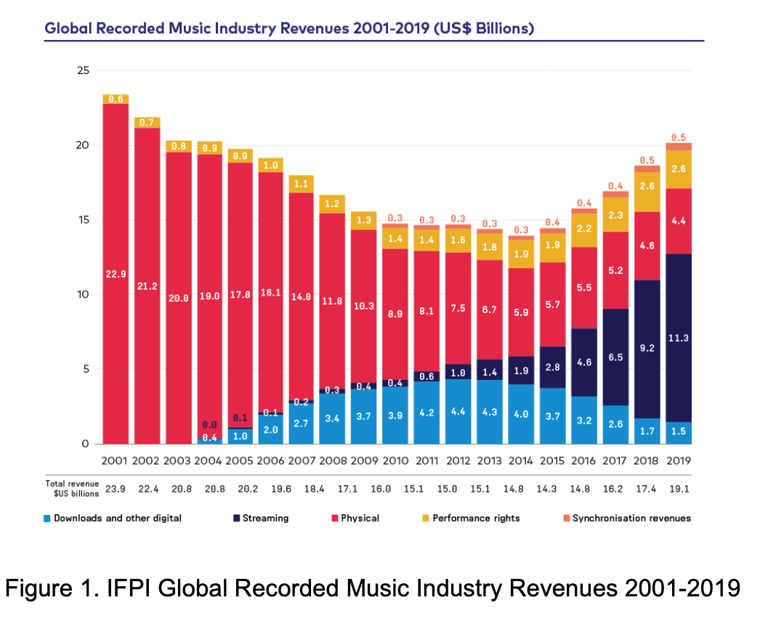
Music Streaming Market
[4]
Notes:
So, why is music streaming important? Well, globally, music streaming services currently boast over 520 million subscribers, and generate upwards of 13 billion dollars in revenue. As you can see on this graph, this number has been steadily growing over the years, and now makes up the majority of the revenue in the global music industry.

Slide 4

Notes:
The service that is indisputably at the top is Spotify, with over 30% market share.

Slide 5
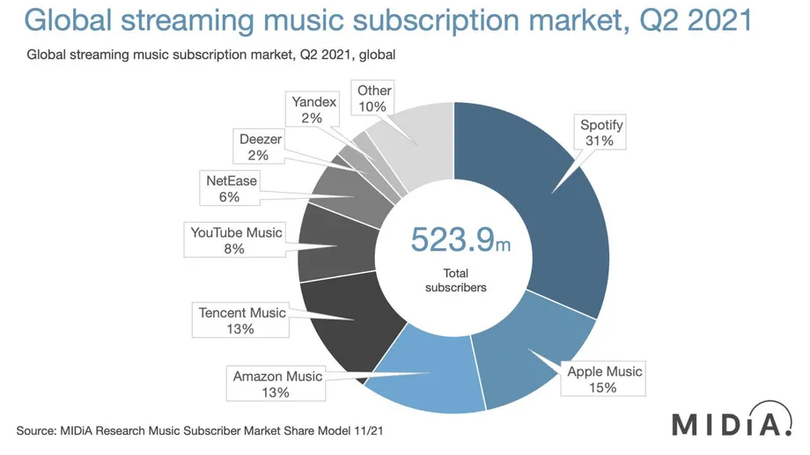
[3]
Notes:
From this chart, you can see that that is over double the market share of its closest competitor, Apple Music. Given that it is such a dominant force in a field as ubiquitous in music streaming, I thought it prudent to discuss some of the ethical issues surrounding spotify.

Slide 6
Outline
Main Ethical Concerns
Unfair Artist Compensation
COVID-19 Misinformation
Military Funding
Possible Solutions
User-Centric vs Pro-Rata?
Take smaller share
Misinformation tags
Remove Joe Rogan Podcast
Decision making transparency
Obstacles
Future
02
Notes:
So, the outline. I’ll quickly go over the 3 main ethical lapses, discuss possible solutions that have been put out there, any obstacles that may arise in implementing those solutions, and how these changes might impact the music industry in the future.

Slide 7
Main Ethical Concerns
1
3
Unfair Artist Compensation
Military Funding
2
COVID-19 Misinformation
Notes:
The 3 main concerns are to do with unfair artist compensation, the spread of COVID-19 misinformation, and military funding.

Slide 8
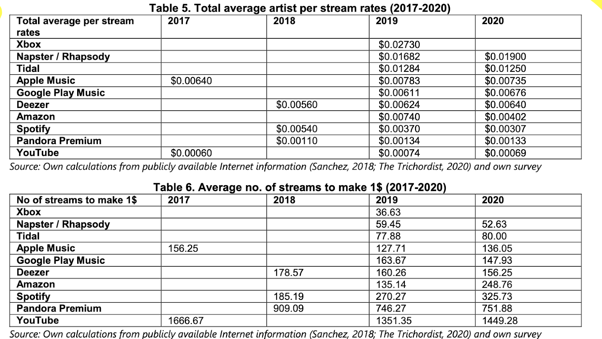
[1]
Notes:
For the first point, Spotify has long been known to pay artists a pittance when compared to competing platforms. In the first table, arranged by earnings per stream in descending order, Spotify is near the bottom, with a paltry rate of 0.00370 dollars per stream. Compare this to Apple Music, its closest competitor, and we see that it pays a much more generous 0.00783 dollars per stream, over twice of what Spotify pays. This perceived unfairness has led to many artists, such as Taylor Swift and Thom Yorke of radiohead publicly denouncing Spotify and removing their discography from the platform for some time. These critiques have actively hurt Spotify’s sales, and garnered outrage from fans, greatly impacting Spotify’s reputation in the music streaming market. This is exacerbated by the fact that national unions, such as the union of musicians and allied workers in America, have actively targeted Spotify due to the poor pay, run campaigns against them in Congress and even pursued legal action. The second ethical concern has to do with the spread of COVID-19 misinformation, which for a platform as big as Spotify can actively harm public health and safety. Prominent podcaster Joe Rogan recently signed an exclusivity deal with Spotify for 100 million dollars. However, this quickly turned sour as Joe Rogan was publicly accused by 270 US doctors, scientists, healthcare professionals and professors in an open letter to Spotify of consistently spreading COVID-19 misinformation and promoting baseless conspiracy theories regarding vaccines, mass hypnosis and psychosis.

Slide 9
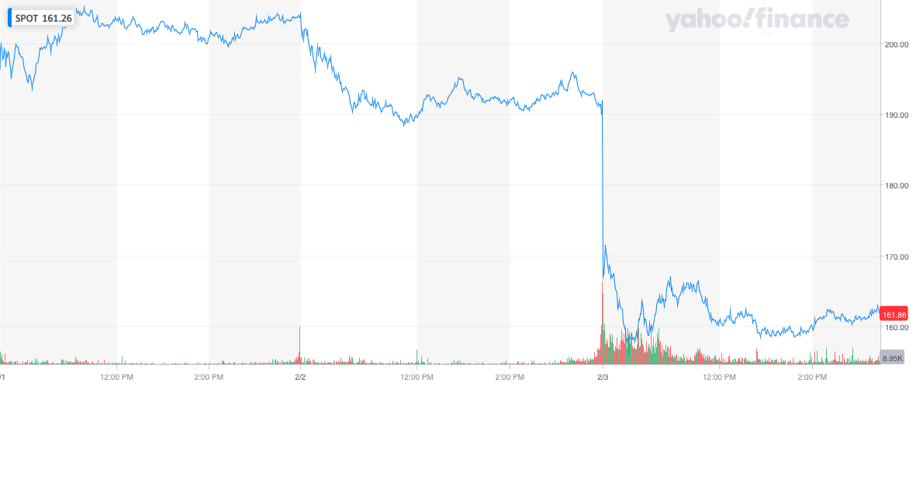
[15]
Notes:
This incident led to many artists such as Neil Young permanently leaving the platform, and massive outrage in the online community with hashtags such as boycottspotify still trending on twitter. However, the damage was not just limited to mass disapproval and public outrage.
The incident actually had a tangible impact on Spotify stock, dropping its value by as much as 18%. The last ethical concern has to do with military funding. Spotify CEO Daniel Ek recently invested 100 million euros into HelsingAI, a European military tech company. Many musical artists felt slighted that not only was Spotify compensating them unfairly and taking a huge share of their royalties, but that Spotify was investing this money into dangerous military investments instead of improving the platform or increasing artists' pay. The lack of transparency around what Spotify does with its share of artists royalties has always been a point of contention, and now that artists know where its being spent, many are personally calling for fans to delete spotify as it goes against their principles.

Slide 10
Possible Solutions
03
Notes:
All in all, we can see that these issues - disregarding artists contribution to the platform, consistently reducing pay, spreading COVID-19 misinformation, and investing into potentially dangerous military and surveillance tech - are not only ethically concerning, but have severely damaged spotify’s reputation and had major effects on its stock price. So, now lets discuss some possible solutions

Slide 11
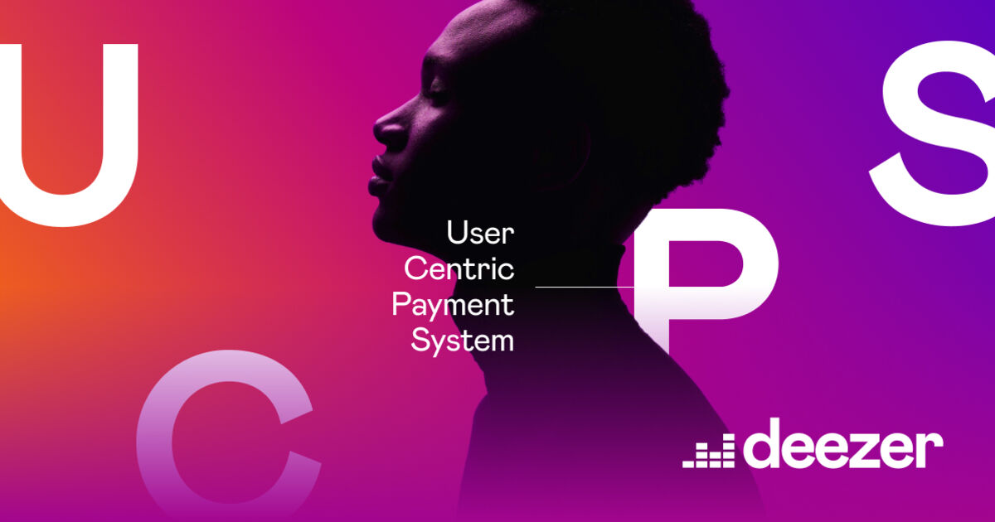
Notes:
The most obvious way to deal with low artist pay is to either increase subscription prices or reduce the share that spotify takes. However, both of these are unfeasible. Streaming services are in a constant battle for low prices, and most have settled at a price of 10 dollars a month. Any increase to this cost is likely to drive users to competing platforms such as Apple music. While some unions such as the union of musicians and allied workers recommend that spotify reduce the share that it takes from artists, that too is unfeasible. Spotify operates on extremely thin margins, and has actually never made a profit, due to the high operating costs and R&D. Reducing the share they take would undoubtedly delay their transition to becoming profitable, and likely turn away investors.
Thus, most research indicates that the way to make spotify more equitable is to adopt something known as a user centric model, that some competitors like deezer have already adopted.

Slide 12
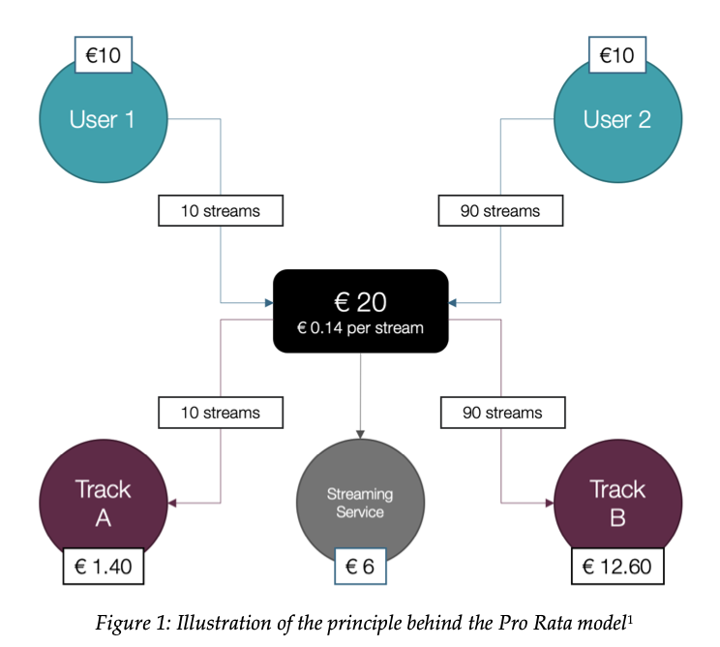
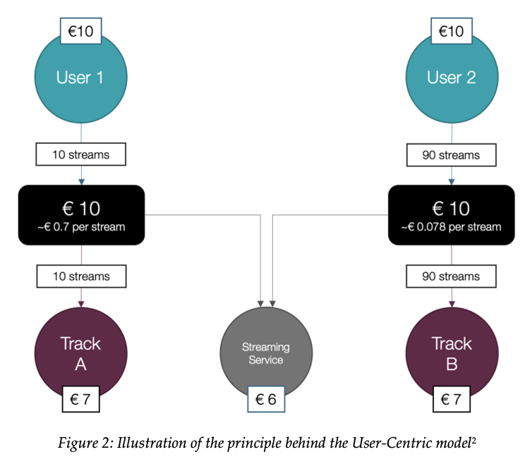
[5]
Notes:
In the current model of payment, known as the pro-rata model, Spotify collects all the money from subscribers into a big pool and then distributes this total to artists based on what percentage of total streams on the platform they account for. However, the problem with this model is that users’ money goes towards artists they might not actually listen to. It disproportionately favours the top artists, and actively redirects money from niche artists to more successful ones. In the user centric model, the money would instead be divided based on what each user actually listens to. Spotify would still earn the same share, but the money would be better divided among all artists, rather than just being concentrated towards the top few artists. In terms of COVID-19 misinformation, it is unreasonable to expect Spotify to remove Joe Rogan from their platform, considering they are investing 100 million dollars in his podcast. Spotify has tried to remedy this problem by placing links to COVID information hubs under any podcasts covering the virus. However, this sort of blanket solution is largely invisible and doesn’t address the actual issue of tackling misinformation. Instead, they should remove particularly egregious examples of episodes from Joe Rogan’s podcast or at the very least place audio content advisories before such episodes to direct users away from such episodes.
In terms of the military tech, it is absolutely Spotify’s right to invest the money into Helsing despite what the artists on their platform think. However, as Spotify slowly continues to bleed users to competitors, it loses the luxury of being the dominant player in the streaming market and doing as it pleases. Spotify has to consider how its actions and investments affect public sentiment and drive away the very people that generate money for Spotify. I believe that encouraging greater transparency and artist involvement in Spotify’s decision-making, perhaps through a representative committee, and providing more clarity as to where Spotify's share of artists royalties is going could appease artists and fans and largely alleviate frustrations.

Slide 13
Prognosis
04
Notes:
To conclude, I think that these changes are necessary for Spotify, especially as competition grows fierce.

Slide 14
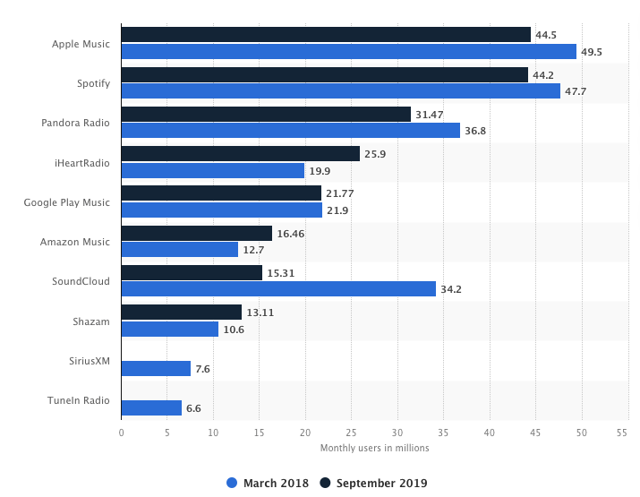
[8]
Notes:
As you can see on this graph, Spotify is slowly losing its grip on the industry. Apple Music has already overtaken Spotify in the US and also garners more support from musicians and fans. The inevitable reputation harm from not improving policies, and the associated stock price volatility that always follows such incidents will make Spotify a much riskier option for investors in the future, and will slow down Spotify’s growth in the future as it struggles to secure funding. It needs to rebuild its reputation with users and artists by listening to their demands and implementing meaningful changes.

Slide 15
Summary
Spotify has been criticized for poor artist compensation, dubious investments, and lack of moderation surrounding COVID-19 misinformation
Its reputation is extremely poor among artists and fans. This is also starting to affect its stock price and reduce investor confidence
Slowly losing ground to competitors such as Apple Music due to issues above. Many artists have also left the platform completely.
It should explore switching to a user-centric payment model like Deezer to make pay more equitable,
It should vet and remove blatant misinformation from Joe Rogan’s podcast.
Spotify should explore involving artists in its decision-making process and offering greater transparency into what it does with its share of artists’ royalties.
05
Notes:
To summarise,
Spotify has been criticised for poor artist compensation, dubious investments, and lack of moderation surrounding COVID-19 misinformation
Its reputation is extremely poor among artists and fans. This is also starting to affect its stock price and reduce investor confidence
Slowly losing ground to competitors such as Apple Music due to issues above. Many artists have also left the platform completely.
It should explore switching to a user-centric payment model like Deezer to make pay more equitable,
It should vet and remove blatant misinformation from Joe Rogan’s podcast.
Spotify should explore involving artists in its decision-making process and offering greater transparency into what it does with its share of artists’ royalties.

Slide 16
References
https://docs.google.com/document/d/11fPjTxGveklFLpNQs6Q9tRgtjg_JTT3tRc9PEQ1q40A/edit
https://www.theguardian.com/music/2020/feb/02/streaming-spells-the-end-of-the-ownership-era-of-music-but-are-we-ready-to-let-go
https://www.midiaresearch.com/blog/music-subscriber-market-shares-q2-2021
https://gmr2021.ifpi.org/report
https://www.koda.dk/media/224782/meta-study-of-user-centric-distribution-model-for-music-streaming.pdf
https://www.fastcompany.com/90704310/spotify-boycott-daniel-ek-investment-defense
https://www.vice.com/en/article/epxxkn/musicians-are-dragging-spotifys-ceo-for-funding-a-military-ai-company
https://www.statista.com/statistics/798125/most-popular-us-music-streaming-services-ranked-by-audience/
https://pitchfork.com/features/article/how-musicians-are-fighting-for-streaming-pay-during-the-pandemic/
https://www.rollingstone.com/music/music-features/should-spotify-change-the-way-it-pays-artists-763986/
https://pitchfork.com/thepitch/is-there-a-fairer-way-for-streaming-services-to-pay-artists/
https://dmfbusiness.fi/pro-rata-user-centric-distribution-models-comparative-study/
https://www.bbc.co.uk/news/technology-54733252
https://www.theguardian.com/technology/2022/jan/26/spotify-neil-young-joe-rogan-covid-misinformation
https://yhoo.it/3LwtT70
https://www.theguardian.com/technology/2022/feb/02/spotify-stocks-fall-rogan-controversy
Notes:
Thank you

